Slide 1
Intro to Data Science
This document is for the exclusive use of Deep Dive bootcamp participants during the bootcamp. This document may not be shared or duplicated

Slide 2
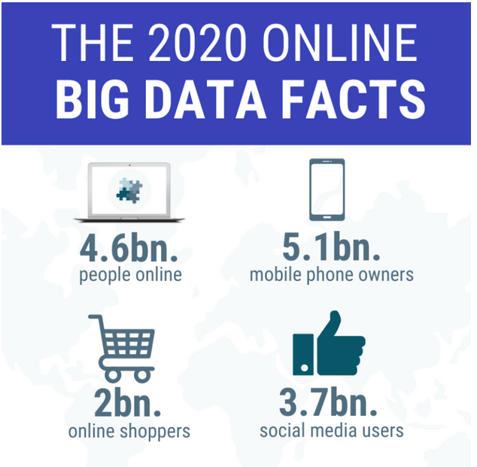
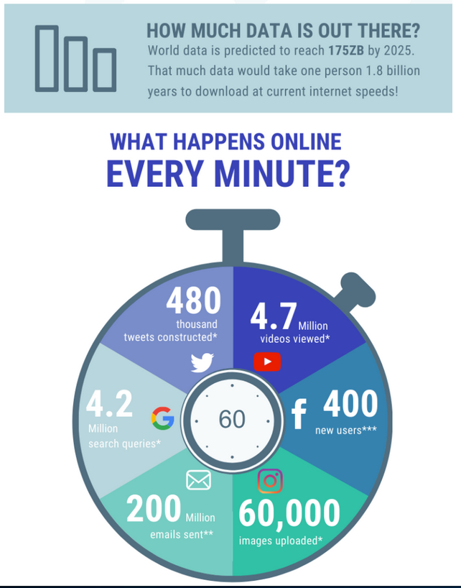

The Data Revolution
Images from https://www.nodegraph.se
This document is for the exclusive use of Deep Dive bootcamp participants during the bootcamp. This document may not be shared or duplicated

Slide 3
What Can Data Do?
Show historical trends and performance
Predict future events & ramifications of actions
Present
Past
Future
Show current state of business
This document is for the exclusive use of Deep Dive bootcamp participants during the bootcamp. This document may not be shared or duplicated

Slide 4
Why Now?
Algorithmic Advances
Data Science
Explosion of Data
Increases in Computing Power/Storage
This document is for the exclusive use of Deep Dive bootcamp participants during the bootcamp. This document may not be shared or duplicated

Slide 5

Who Can Benefit From Data?
Not just mega-organizations or tech
Non-technical use cases
Sports teams: Maximizing bang for buck
Health/medicine: Reactive to preventative
Retail: Recommending products, predicting customer behavior
This document is for the exclusive use of Deep Dive bootcamp participants during the bootcamp. This document may not be shared or duplicated

Slide 6

Ways to Use Data
Predict
Predict outcomes such as customer behavior, product prices, or health measures
Example: Volvo Trucks
Volvo partnered with IBM to monitor data collected from Volvo Group trucks.
Using this data and machine learning, they can predict component failure in the truck and produce preventative maintenance solutions.
https://www.ibm.com/case-studies/volvo-group
https://commons.wikimedia.org/wiki/File:Oevlk_-_Volvo_VNL.jpg

Slide 7

Ways to Use Data
Cluster
Behavior segmentation, pinpoint marketing, filtering nuisance material
Example: Salesforce
Salesforce has implemented a way for users to cluster their data. For example, accounts can be clustered based on characteristics such as number of employees, annual revenue, etc.
https://help.salesforce.com/s/articleView?id=sf.bi_integrate_recipe_transformation_cluster.htm&type=5
https://commons.wikimedia.org/wiki/File:Salesforce_Users_Email_list.png

Slide 8

Ways to Use Data
Optimize
Price points, marketing campaigns, inventory levels
Example: Stitch Fix
They need to determine which styles to purchase, how to allocate inventory appropriately to different warehouses, and when to remove old inventory to make room for new styles
Use robust optimization on a model of their inventory system that was fit to historical data
https://algorithms-tour.stitchfix.com/#inventory-management
https://commons.wikimedia.org/wiki/File:Stack_and_box_fall.jpg

Slide 9
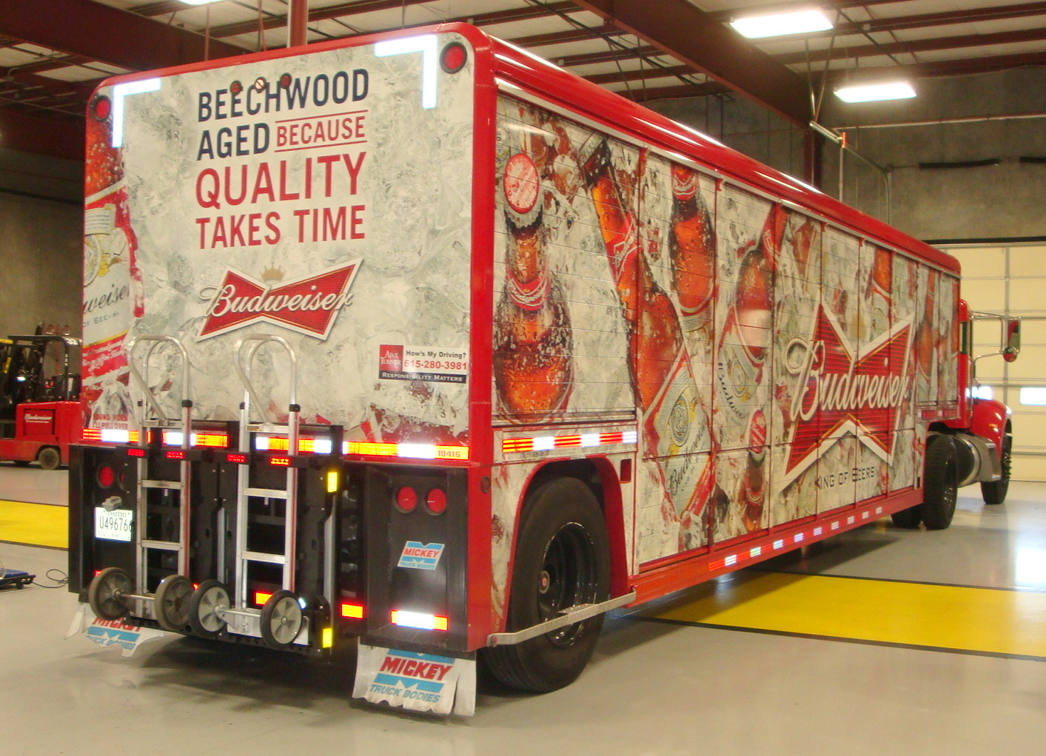
Ways to Use Data
Detect
Fraudulent activity, cyber-attacks, objects in images, process anomalies
Example: Anheuser-Busch InBev
Launched a platform called "BrewRight" that monitors transaction activity across 100 countries and uses machine learning to identify fraud and corruption.
Used to help ensure compliance with the Federal Corrupt Practices Act
https://www.ab-inbev.com/news-media/innovation/how-brewright-is-rooting-out-corruption-at-ab-inbev-and-beyond/
https://commons.wikimedia.org/wiki/File:Budweiser_Beer_Anheuser_Busch_InBev_Brewing_Company.jpg

Slide 10

Ways to Use Data
Recommend
Recommend movies, books, or other items for purchasing
Example: Netflix Recommender System
Netflix uses a personalized recommender system to recommend movies to watch.
Netflix has about a 90-second window to help viewers find a movie or a TV show before they leave the platform.
Netflix’s recommendation system produces $1 billion a year in value from customer retention.
https://medium.com/@springboard_ind/how-netflixs-recommendation-engine-works-bd1ee381bf81
https://commons.wikimedia.org/wiki/File:Netflix-new-icon.png

Slide 11
What is Data Science?
Artificial Intelligence (AI)
The development of a machine that can simulate human behavior.
Machine Learning (ML)
The process of a machine learning from data and making decisions without explicit programming.
Deep Learning (DL)
A term associated with a ML algorithm involving artificial neural networks that work to mimic neurons in the brain.
Data Science (DS)
The process of using data analytics, statistics, and programming to solve business problems.
AI
ML
DS
DL
This document is for the exclusive use of Deep Dive bootcamp participants during the bootcamp. This document may not be shared or duplicated

